Slide 1
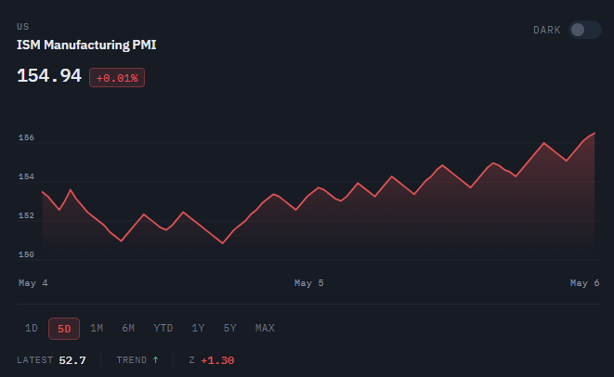
FUNDAMENTALS CHARTS

Slide 2
MOMENTUM CHARTS

